Slide 1
Plastic Manufacturing Processes
Plastic Conversion Processing
Notes:
Introduction
Welcome
Background to FPC
Important contribution to the food industry

Slide 2
Plastic Types
Thermoplastic polymers
Polyethylene, Polyester, Polyamide
Elastomers
Rubbers, Silicones
Thermosetting polymers
Epoxies, Polyesters,

Slide 3
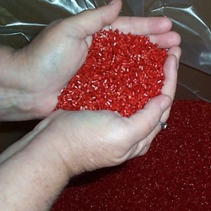
Introduction to Plastic Conversion

Slide 4
Elementary Conversion Process
Solids handling
Mixing
Drying
Melting
Mixing
Pressurisation & pumping
Devolatizing & Stripping

Slide 5
Finishing Conversion Processes
Die forming
Moulding & Casting
Mould Coating
Secondary shaping

Slide 6
Properties
Processes
Polymers

Slide 7
Process selection
Technical Issues
Dimension tolerance, wall thickness, polymer, size, geometry
Economic Issues
Number requires, finished cost, tooling cost, production rate

Slide 8
Material Preparation
Drying
Additives

Slide 9
Drying
Some polymers really adsorb moisture
Nylon 2.5% @50%rh 23ºC
Moisture can reduce intrinsic viscosity (IV)
Dehumidification driers
Regeneration to reduce energy
Temperature must not melt polymer

Slide 10
Additives
Heat stabilisers
Antioxidants
UV stabilisers & Inhibitors
Slip agents
Anti-static agents
Anti-blocking agents
Anti-fog agents
Colours
Plasticisers

Slide 11
Additives
Masterbatch
Concentrated mix of polymer carrier and active ingredient
Polymer Specific Masterbatch
Universal Masterbatch

Slide 12
Mixing
Little mixing in single screw extruders
Mixing initiated in hopper or in batches before being feed into hopper

Slide 13
Extrusion

Slide 14
Processes
Extrusion
profile
cast sheet and film
blown film
co-extrusions

Slide 15
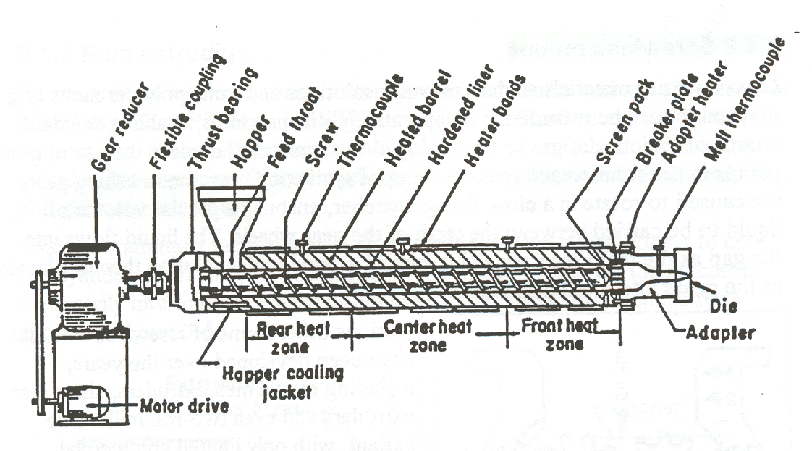
Extruder Operation

Slide 16
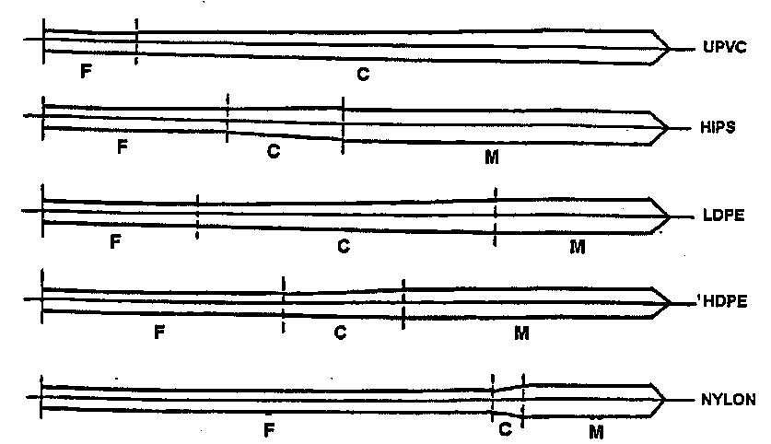
Extruder Screws

Slide 17
Extrusion
Heat generated from overcoming friction
Screw profiles designed for each polymer
Little mixing in single screw extruders
Usually continuous process

Slide 18
Profile extrusion
Profile die fitted to end of extruder to shape melt.
Die swell and profile thinning
Knit lines can be source of weakness
Applications
Mastic tubes, sweat tubes

Slide 19
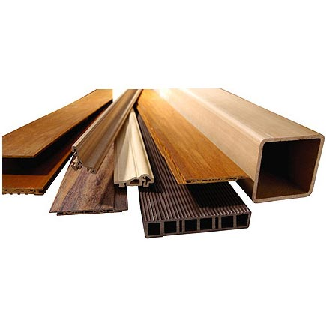
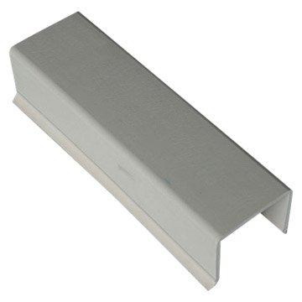
Profiles

Slide 20
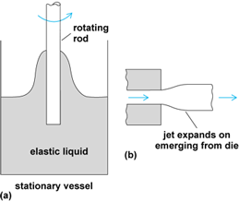
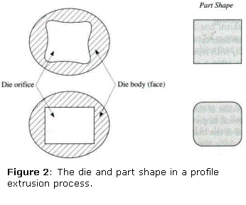
Die Swelling
extrudate swell (youtube.com)

Slide 21
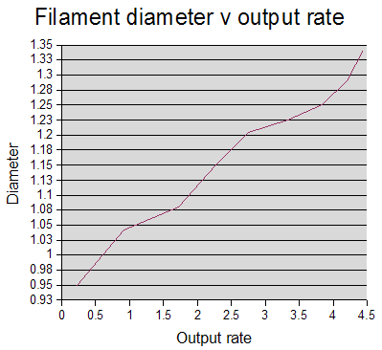
Die Swelling

Slide 22
Sheet and cast film extrusion
Profile extrusion with an adjustable slot die
Sheet extruded onto chilled casting rollers
Rapid cooling of thin sheet
Thick, uneven edges trimmed off
Limit gauge bands
Windup rollers oscillated or automatic thickness control

Slide 23
Sheet die

Slide 24
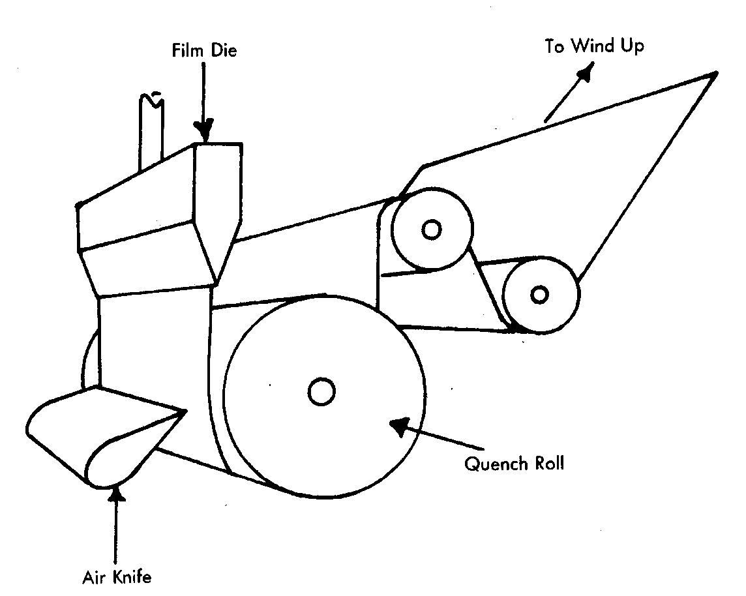
Cast Film Extrusion Line

Slide 25
Orientation
Orientation of molecules in one or more directions
Can cause desirable and undesirable changes in the properties of the material.

Slide 26
Orientation
Achieved by stretching the material at a temperature between Tg and Tm and cooling to lock in orientation.
Film may shrink if subjected to temperatures similar to those at which the orientation took place.

Slide 27
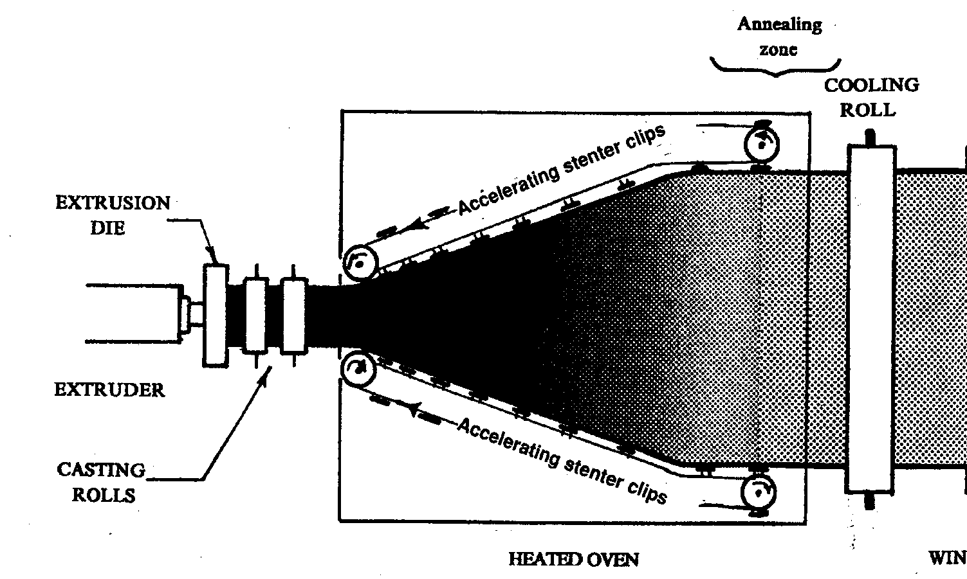
Orientation of cast film

Slide 28
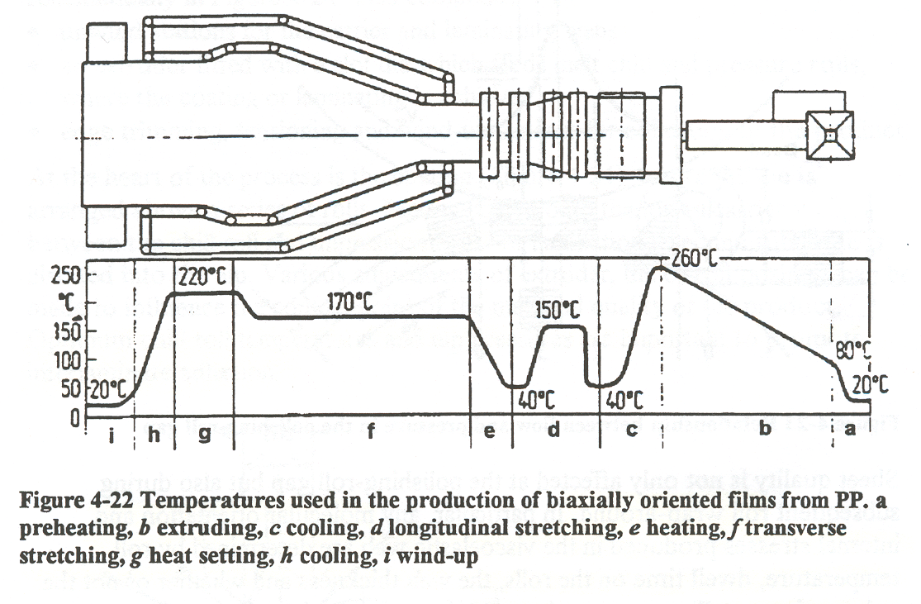
Orientation of cast films

Slide 29
Blow Film Extrusion
Similar to profile extrusion
Produce tube of molten polymer which is inflated with air and air cooled.
Difficult to control melt drawing
Tube collapsed, slit and rolled
Controlled windup speed and bubble pressure

Slide 30
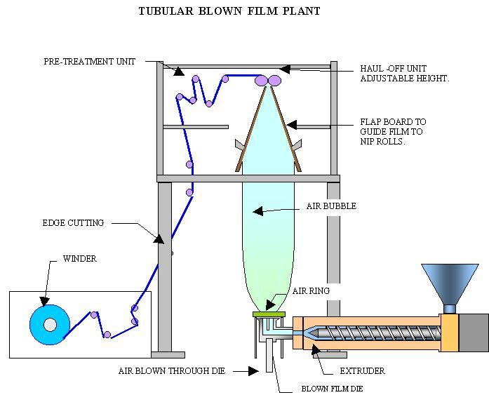
Blown Film

Slide 31
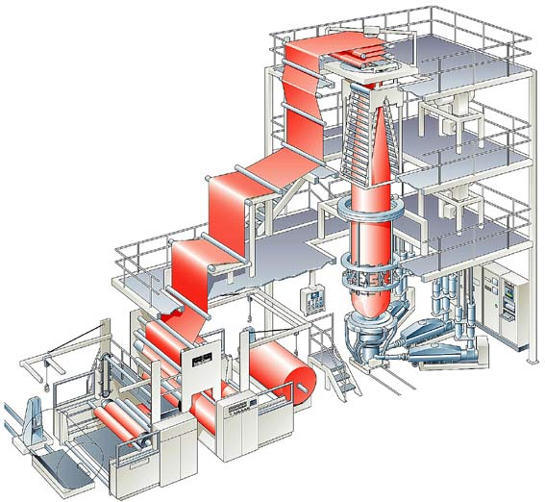
Blown Film
BOPP Process - YouTube

Slide 32
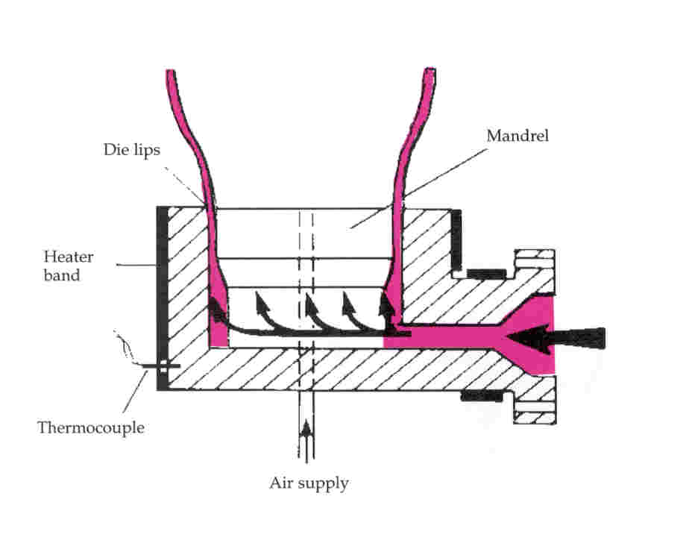
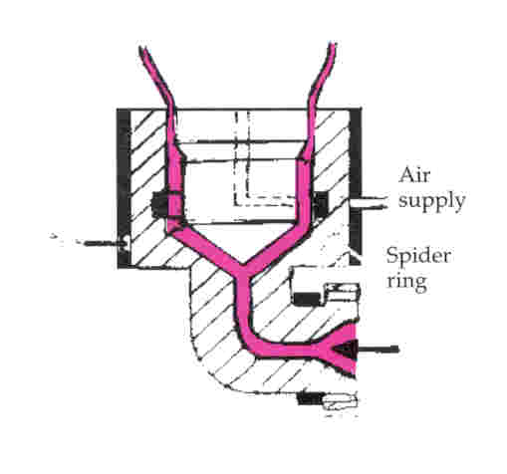
Blown Film Die

Slide 33
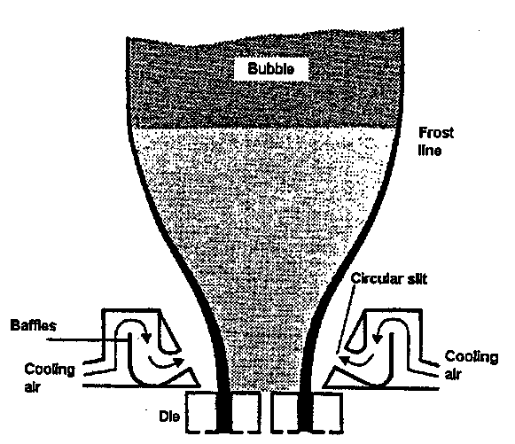
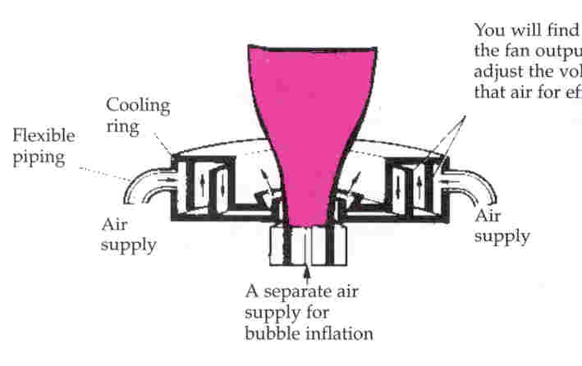
Blown Film External Cooling

Slide 34
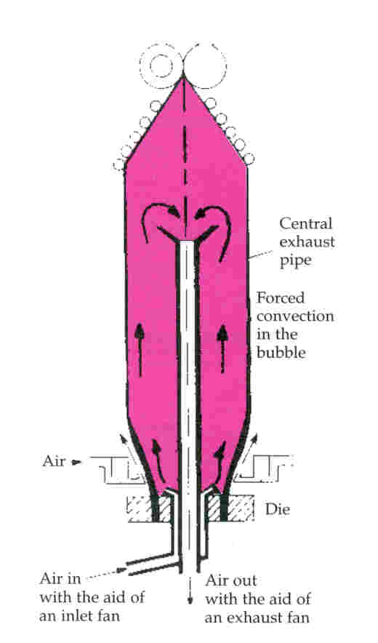
Blown Film Internal Cooling

Slide 35
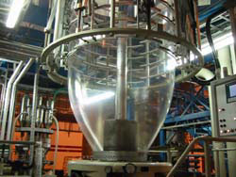
Measurements
Blow Up Ratio (BUR)
Draw Down Ratio (DDR)
Effect
Gauge
Orientation

Slide 36
Co-Extrusion
Produce combination of two or more materials
Enable thin barrier layers to be included in materials
Process scrap not recyclable

Slide 37
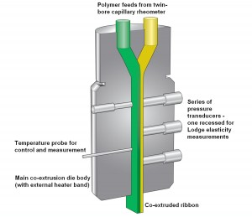
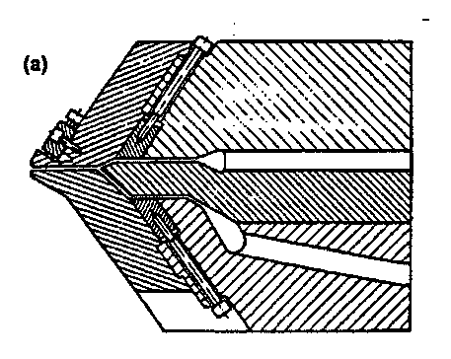
Co Extrusion Sheet Die

Slide 38
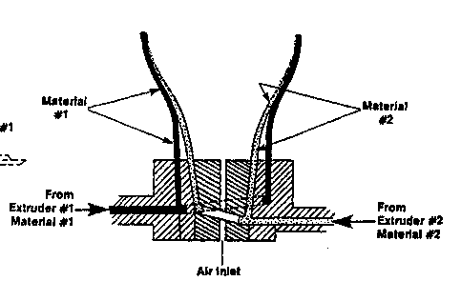
Co-Extrusion Blown Film Dies

Slide 39
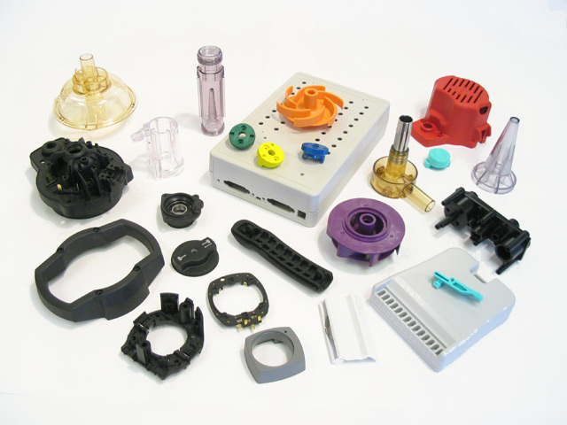
Injection Moulding

Slide 40
Plastic Injection Molding
High pressure melt forced enclosed to closed mould
Mould cavity approximately same shape as item
Produce complex products in single process

Slide 41
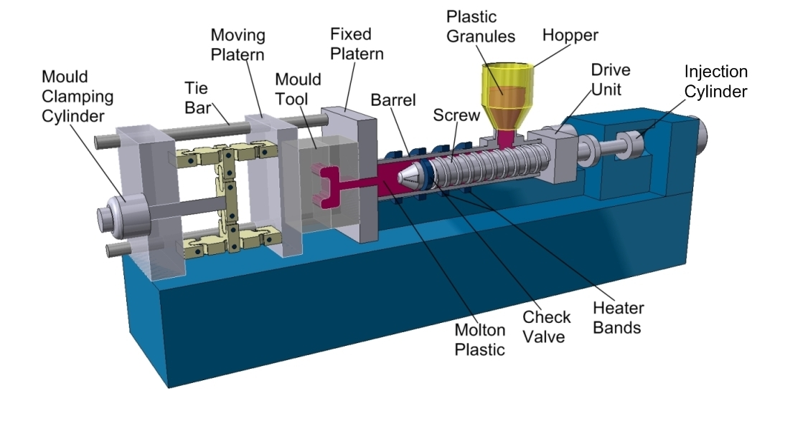
Injector

Slide 42
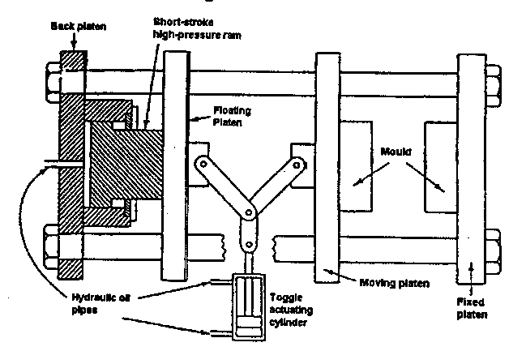
Toggle Switch

Slide 43
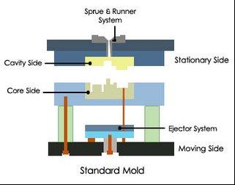
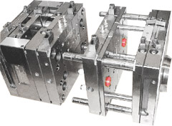
Mould

Slide 44
Mould design
Heavy to withstand pressure
Permit air removal
Avoid unequal cross-section
Provide balanced flow
Avoid weld lines in stressed areas

Slide 45
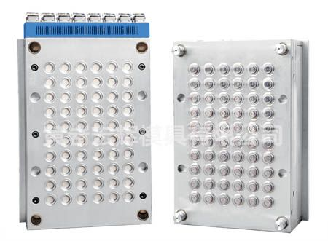
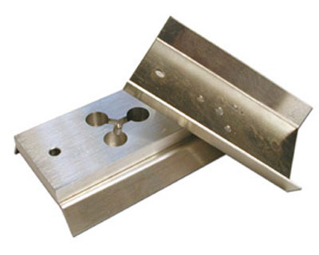
Multi Cavity Moulds

Slide 46
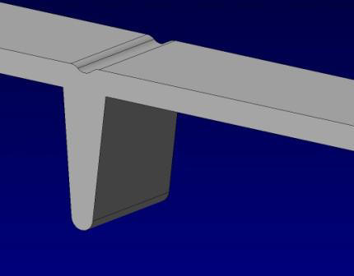
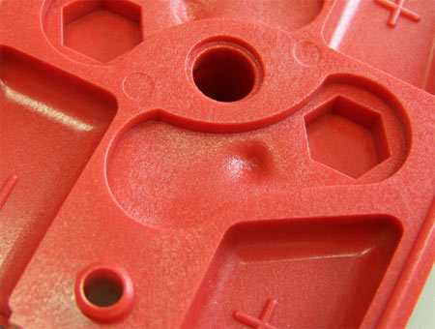
Common Injection Molding Defects

Slide 47
Co-Injection Moulding
Overmoulding
Preform is manufactured
Preform placed into the injection mould
Plastic moulded around / in the preform
E.G. Soft touch closures

Slide 48
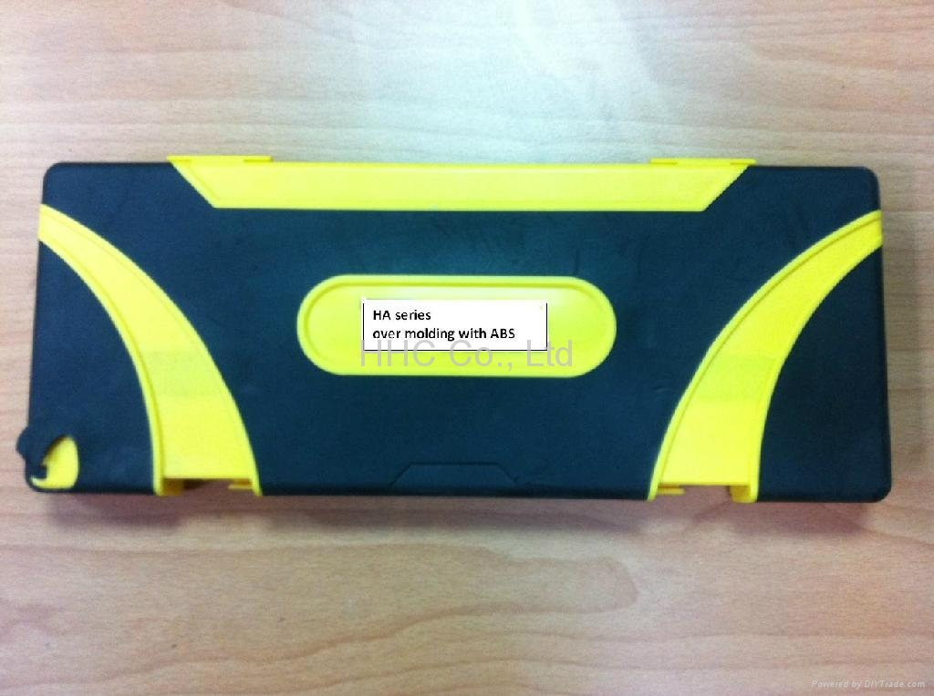
Injection over moulding

Slide 49
Injection co moulding
Injection of two materials into same mould
Skin/core/skin formation
“Fountain flow” ensures skin is filled with core.
Skin material injected at end to prepare for next cycle.

Slide 50
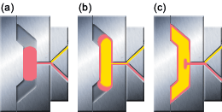

Slide 51
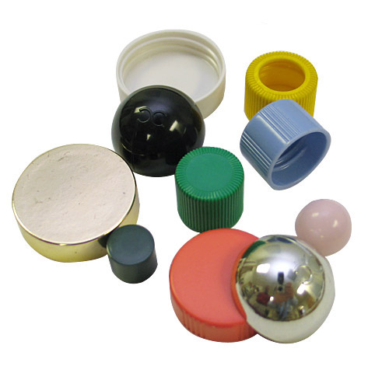
Compression Moulding

Slide 52
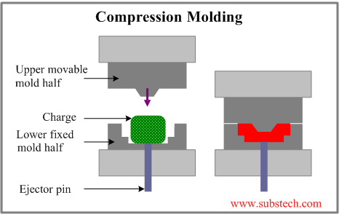
Compression Moulding

Slide 53
Compression Moulding
Charge
Powder, paste or solid
Placed into heated mould and compressed
Shaped and polymerisation process completed

Slide 54
EPS Moulding
EPS beads contain blowing agent
Pre blown with steam heating
Feed into mould
Blown and fused with heat.

Slide 55
Extrusion Blow Moulding

Slide 56
Extrusion Blow Moulding
Manufacture of hollow shapes, bottles drums etc.
Involved extrusion of parson, clamping in mould and blowing.
Cyclic operation

Slide 57
Extrusion Blow Moulding
Parson extrusion
Clamping in mould
Inflation & cooling
Ejection from mould
Flash removal
Leak testing

Slide 58
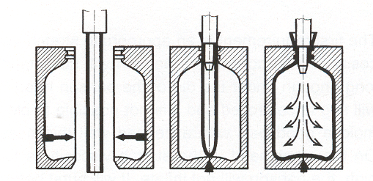
Extrusion Blow Molding

Slide 59
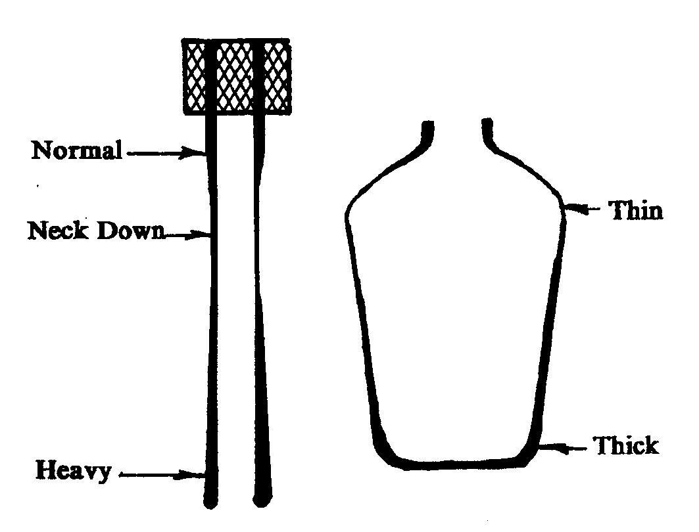
Material Distribution

Slide 60
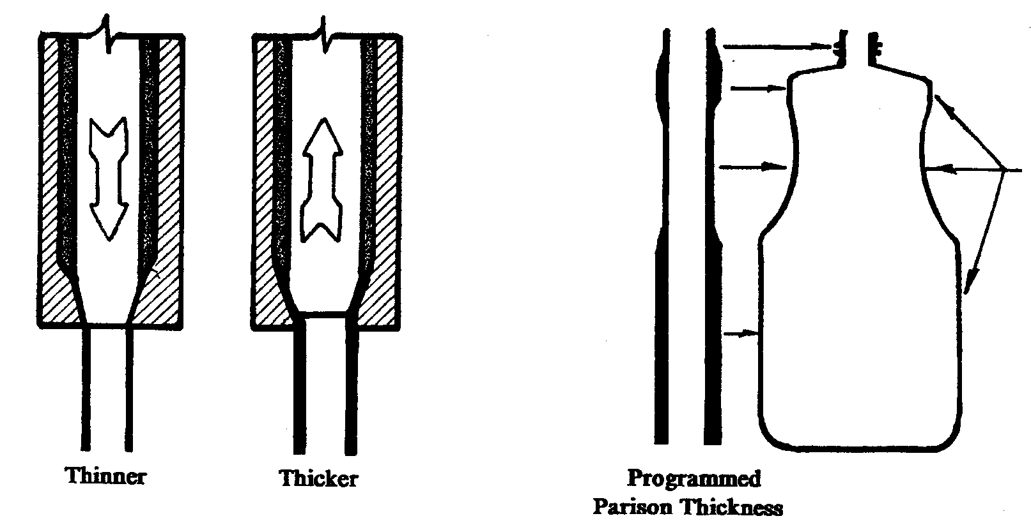
Programmed Parson

Slide 61
Mould Design
Hardened inserts at high wear areas
Must seal and can trim bottom
Provide for rapid cooling
Provide for air removal from cavity
Accurately locate mould halves.

Slide 62
Features
Can be co-extruded
Can incorporate handles, and asymmetric design.
Moderate dimension tolerance
Cycle rate controlled by cooling time
Only require one lightweight mould

Slide 63
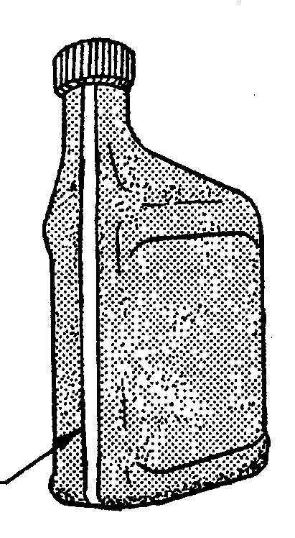
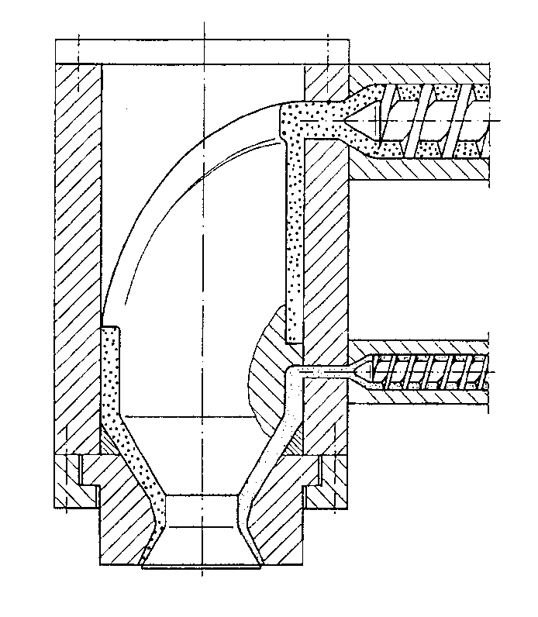
Co-extrusion

Slide 64
Injection Blow Moulding

Slide 65
Injection Blow Moulding
Injection moulded parson or preform
Preform blown to produce container
Used for precision finishes, wide mouth containers etc.
Requires two moulds,- expensive set-up costs
No waste
Difficult to produce handles, co-extrusions

Slide 66
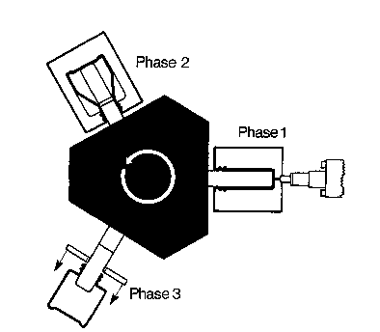
Injection blow moulding

Slide 67
Stretch Blow Moulding

Slide 68
Stretch Blow Moulding
Blowing causes orientation in hoop direction
To provide bi-axial orientation must be stretched in longitudinal direction
Can be injection or extrusion stretch blow moulding

Slide 69
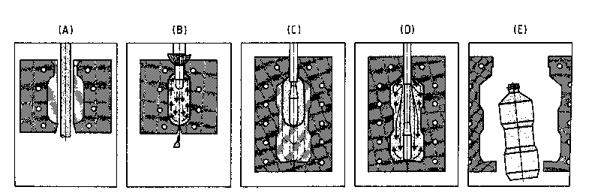
Extrusion Stretch Blow Moulding

Slide 70
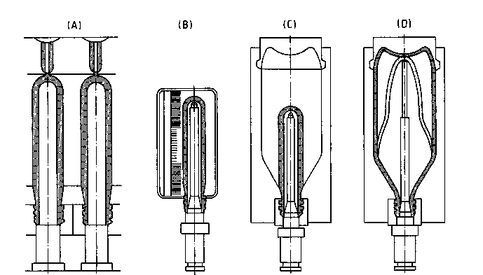
Injection Stretch Blow Moulding

Slide 71
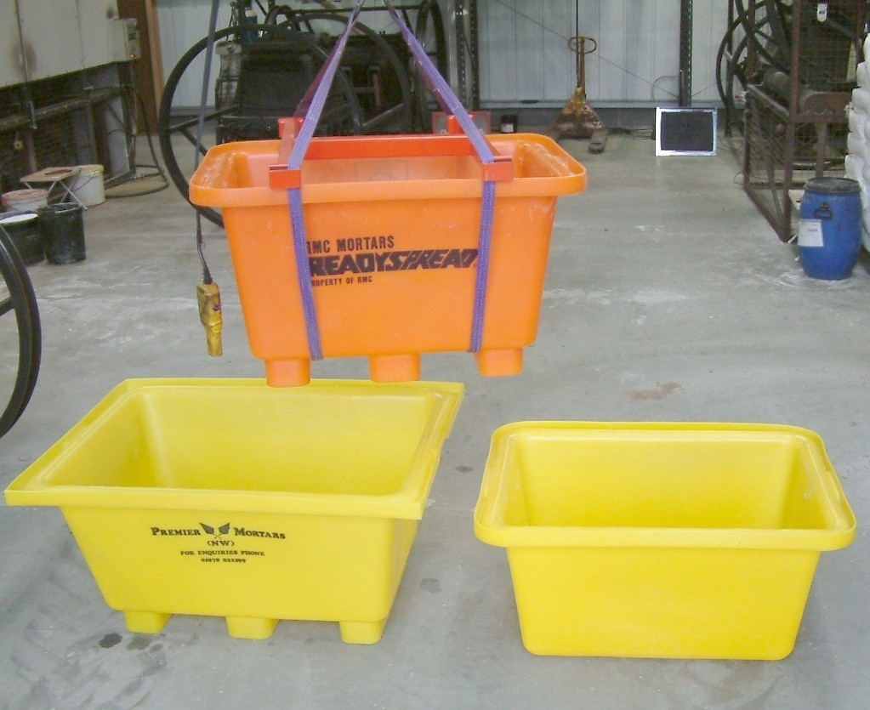
Rotational Moulding

Slide 72
Rotational Moulding Mould coating
Metal Mould for heat transfer
Polymer powder placed into mould
Mould transferred into oven & heated
Mould rotated about 2/3 axis through
Polymer melted and coated onto inner surface
Mould cooled
While being rotated
Opened and part removed

Slide 73
Rotational Moulding
Slow process
Little waste, some finishing required
Think material layers
Cheap moulds
Only for complete vessels

Slide 74
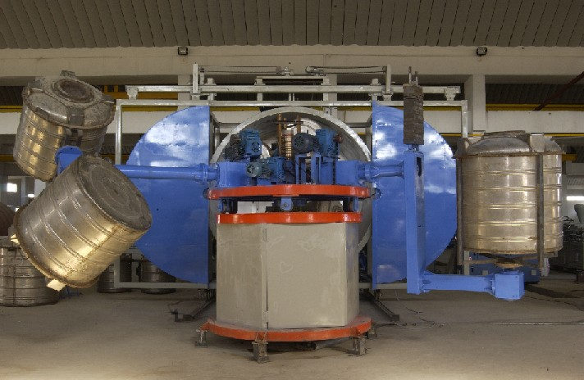
Rotational Moulding

Slide 75
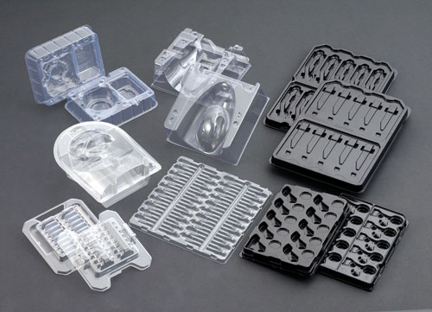
Thermoforming

Slide 76
Thermoforming
Secondary shaping for sheet material
Simple shapes and designs
Low set up costs
Produces uneven material distribution
Widely used for trays, tubs, and inserts.

Slide 77
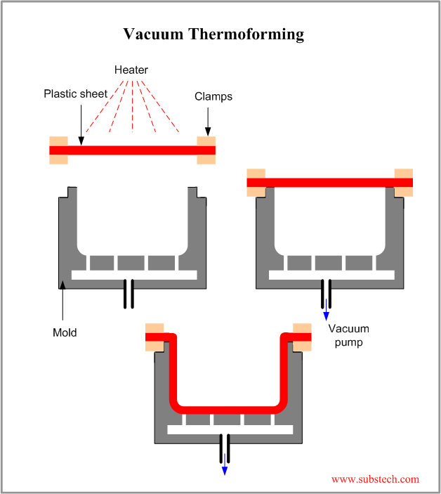

Slide 78
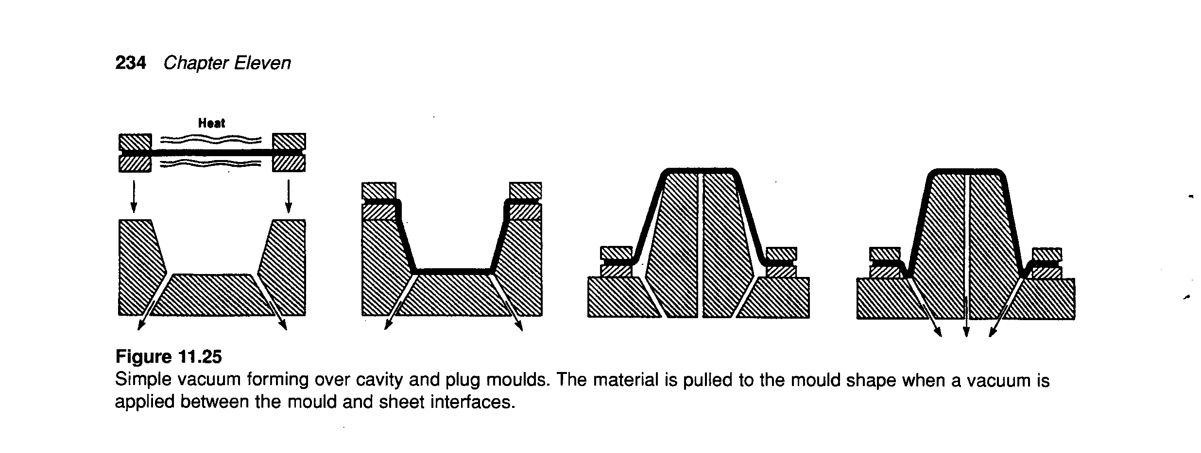
Vacuum thermoforming

Slide 79
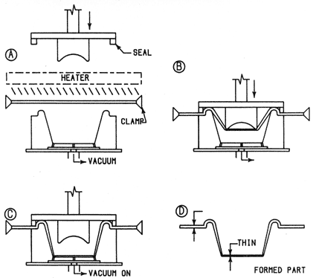
Plug Assist Thermoforming

Slide 80
Properties
Processes
Polymers

